Slide 1
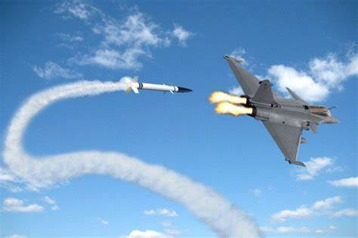

EE555-Automation Lab
LQR Control for Missile Guided System
Group Members
PAWAN KUMAR (224102510)
NIRMAL KUMAR (224102509)
MOHD. AHKAMUDDIN SIDDIQUI (224102508)
Project Supervisor
Dr. Parijat Bhowmick
Assistant Professor
(EEE Department)
TEACHING ASSISTANTS
Mallemputi Aravind
Salam Athoibi Devi

Slide 2
INDEX
Introduction
Proportional Navigation
Proportional Navigation law for acceleration
Homing Loop
Optimal Control for Guidance
State Space Representation
Optimal Problem Statement and Matrix Hamiltonian
Optimal control Input
Missile Control and Guidance
Simulation Result
Conclusion
References

Slide 3

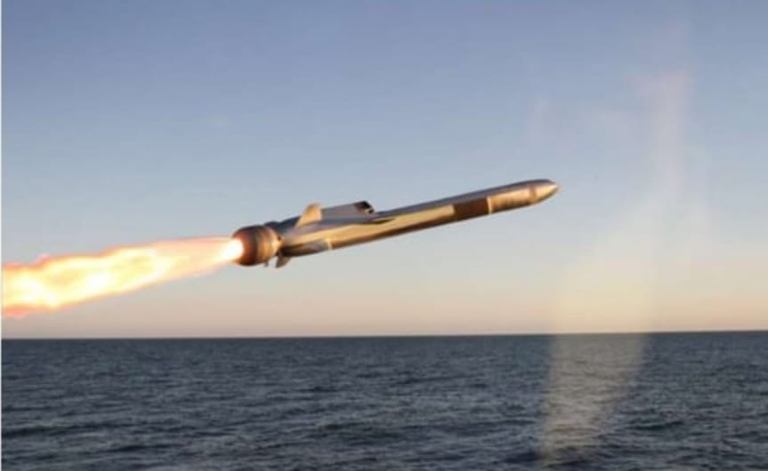
Missile Guided System
Basically any object thrown at a target with the aim of hitting it is a missile. Thus, a stone thrown at a bird is a missile.
Guided missile imparted with some intelligence and quick response to move with respect to the target, to overcome aiming errors and the target evasive actions and hit it accurately.

Slide 4
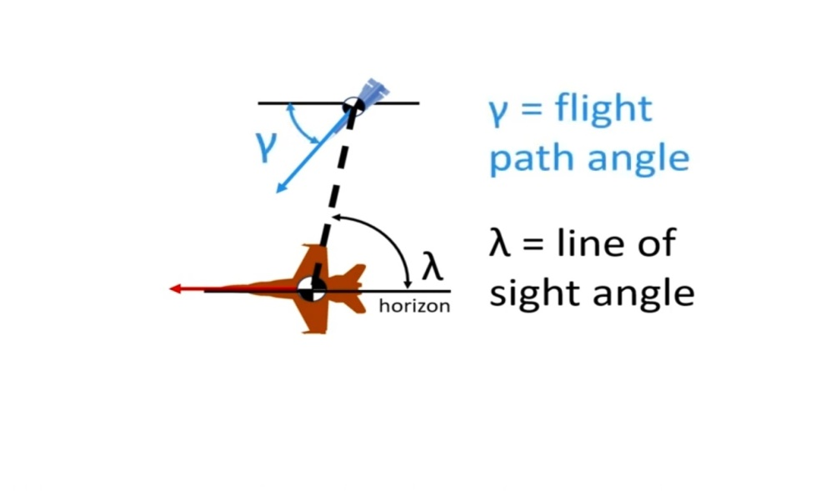
Proportional Navigation
It is implemented as part of process known as
homing loop
Observe a collision course:
collision course or collision triangle is achieved when LOS angle is constant in time.(Not happening here)
Concept: Rotate Pursuer velocity vector as LOS changes

Slide 5
Continued….
Propose:
= Flight Path Angle Rate
= Navigation Gain
= LOS Rate
Let then
It solves desired flight path angle at future point in time.

Slide 6
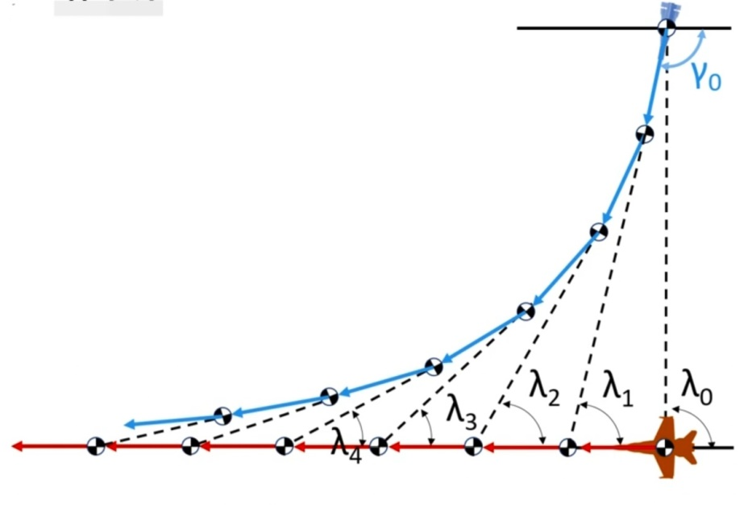
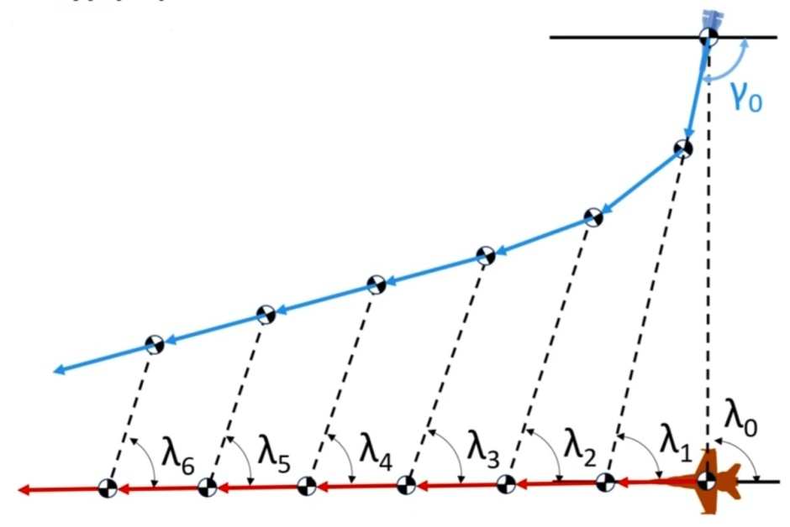
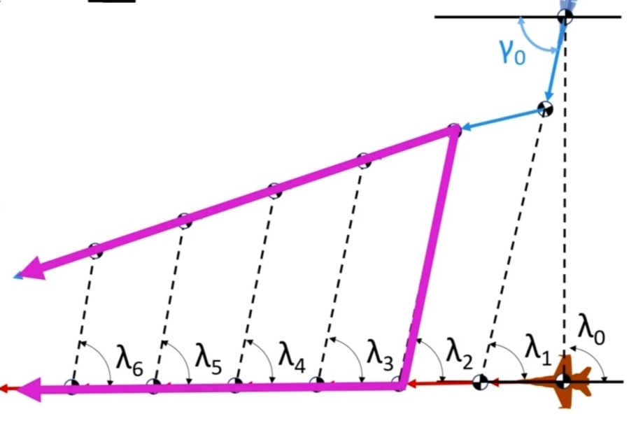
N=1
N=3
N=5

Slide 7
List of Variables
P – Missile β – Target flight path angle
T – Target RP/T – Range to Target(vector)
VP – Pursuer velocity mag Fi – Inertial reference frame
HE – Heading error Fp - Pursuer reference frame
L – Lead angle FT - Target reference frame
γ – Flight path angle
λ – Line of Sight angle
ap –PN Acceleration
VT – Target velocity magnitude
aT – Target accelration magnitude

Slide 8
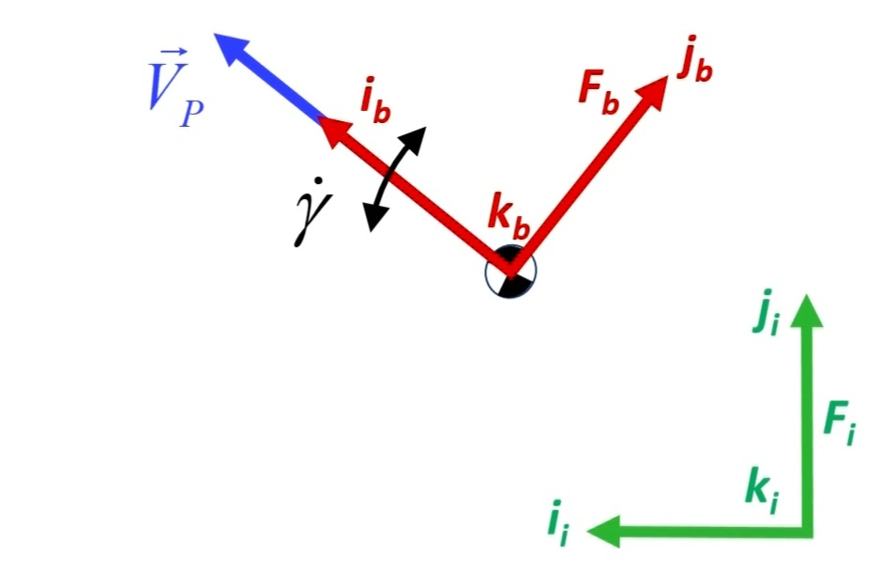
Proportional Navigation Law for Acceleration
Assuming pursuer velocity magnitude is constant
Vector derivative or equation of cariolis:

Slide 9
Continued…
Evaluate cross product
set

Slide 10
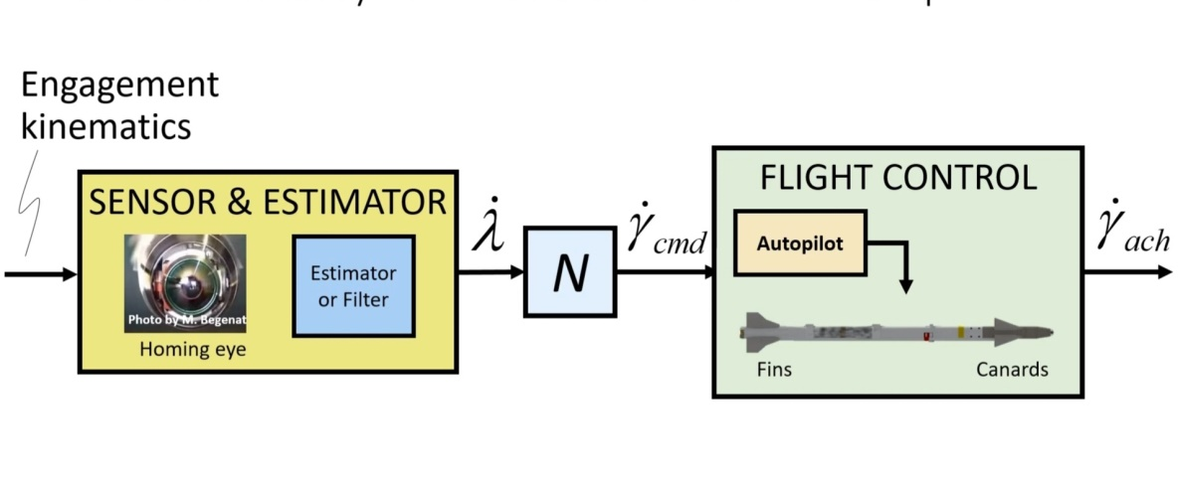
Input data to ProNav Law
Sensors and Estimator:
Seeker or Homing-eye(IR or RADAR)
It uses EM wave actively or passively to detect and track target.
It generates LOS rate or commanded acceleration

Slide 11
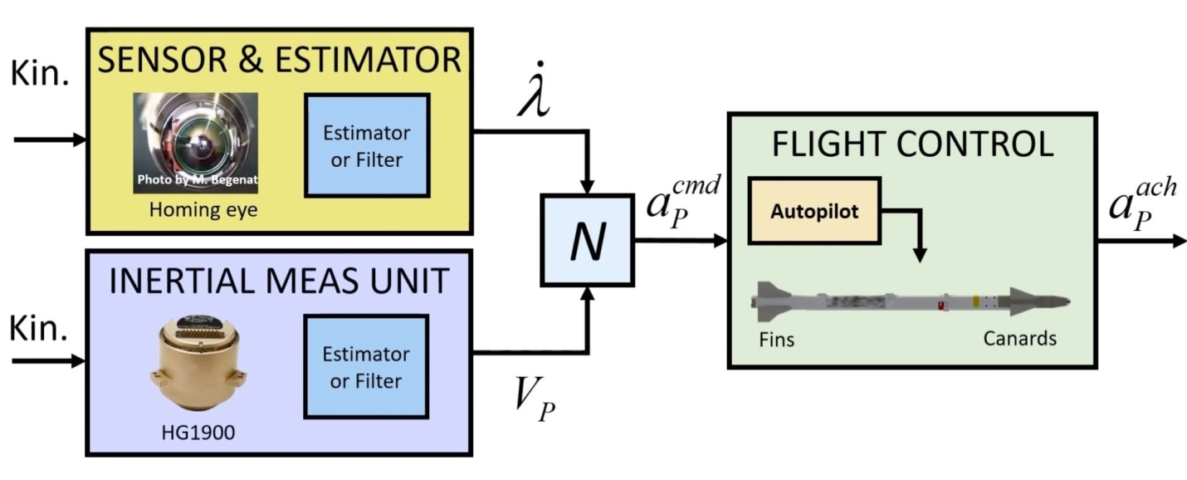
Inertial Measurement Unit
Inertial Measurement Unit: Senses Translational & rotational acceleration that data
It can be filtered to produce an estimate of the pursuer velocity vector.

Slide 12
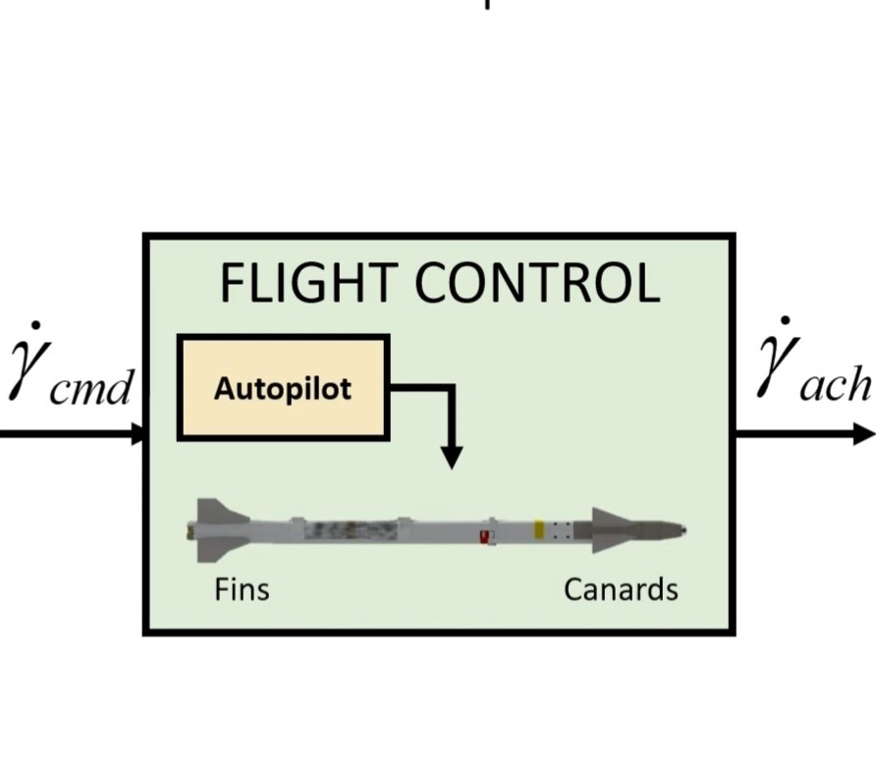
Output to ProNav
Flight Control or Autopilot : It equipped with control effectors ,it imparts forces and moments on the body two potential forms are fins and canards to produce desired signal.
Its job of autopilot to relate the commanded acceleration to the correct servo-fin or servo-canard motion to produce achieved acceleration that best meets the command

Slide 13
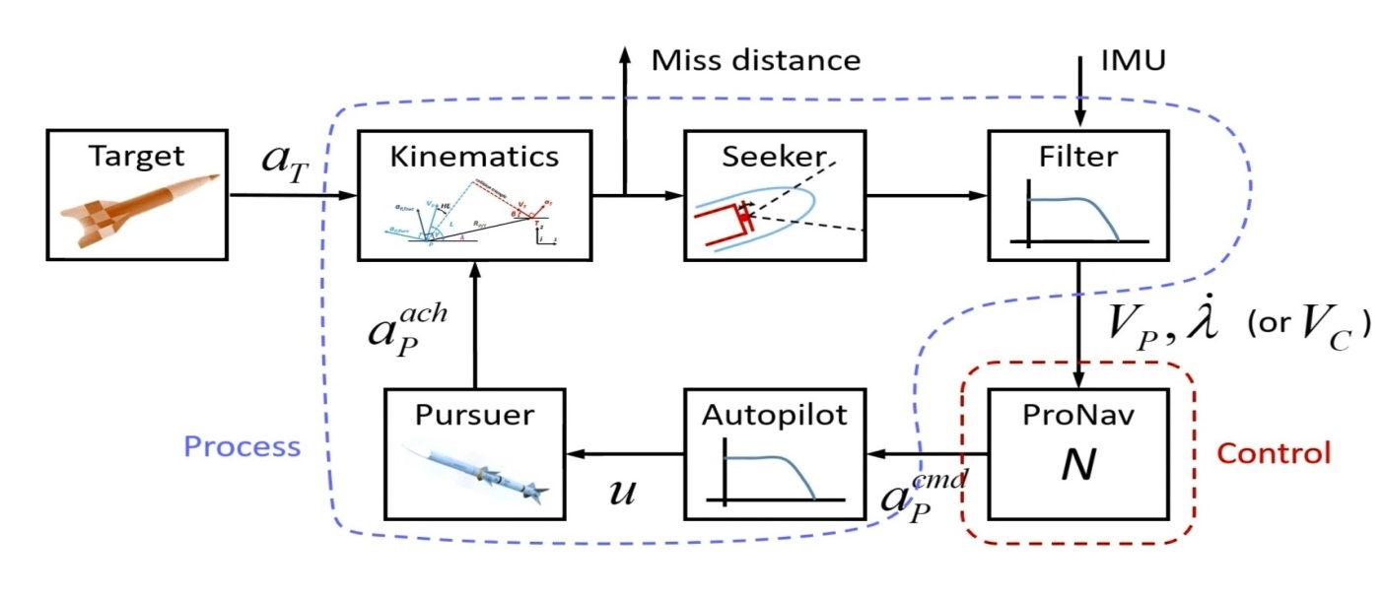
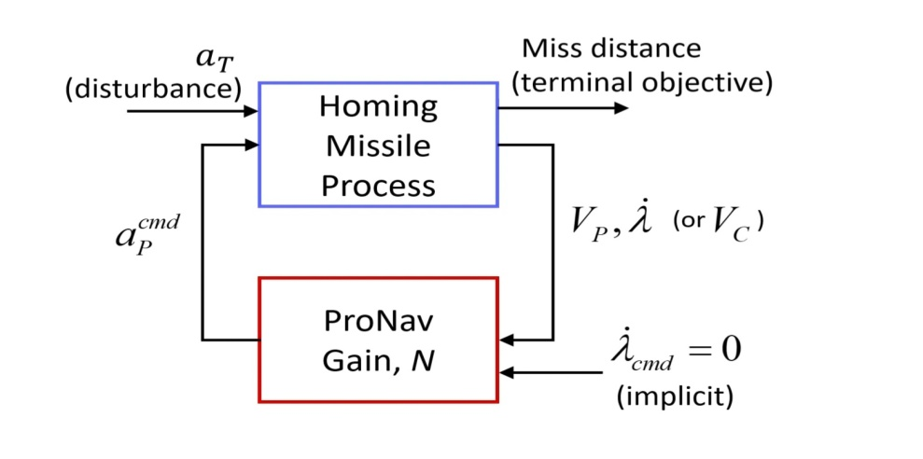
Homing Loop

Slide 14
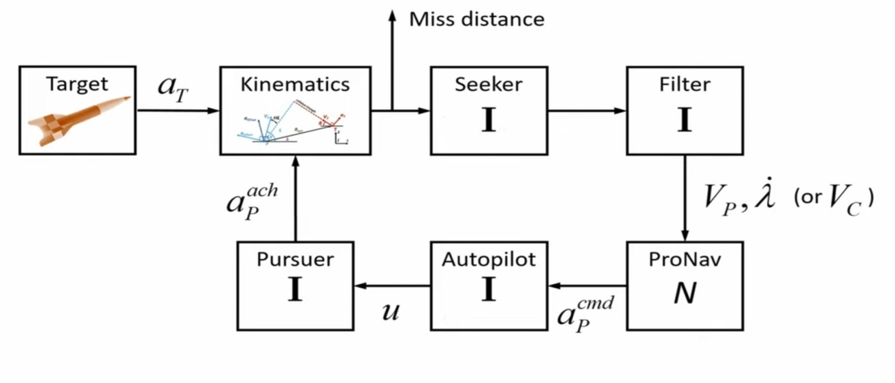
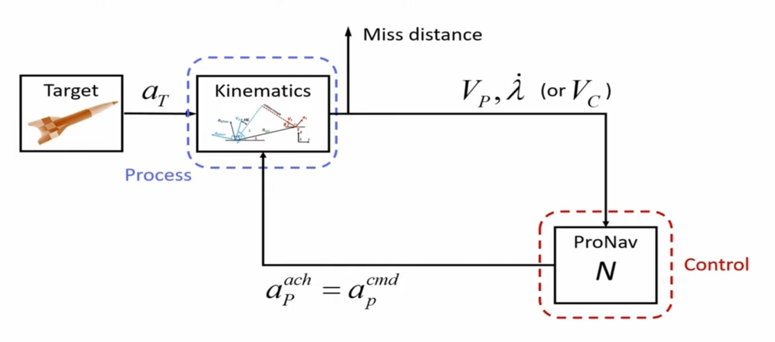
Continued…

Slide 15
Closing Velocity
Closing velocity
Closing
velocity
From chain rule’s

Slide 16
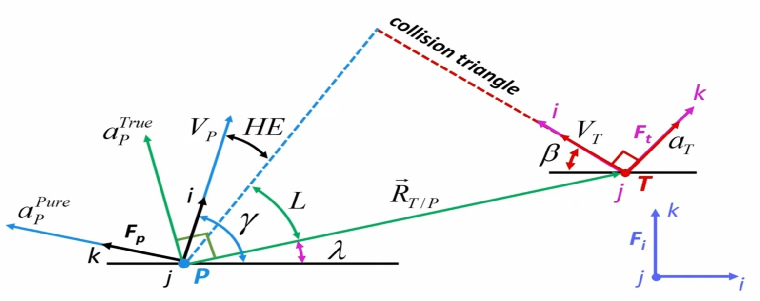
Optimal Control for Guidance
Target can actually accelerated as manuever to make intercept more difficult.
Assume linearized engagement L,γ,λ,β are small.
Pursuer acceleration assumed to be perfect.

Slide 17
State Space Representation
States are Z1,Z2 and Z3
State equation -
Z1=Relative Position
Z2=Relative Velocity
Z3=Relative Acceleration

Slide 18
Optimal Problem Statement
Find over some finite interval that minimizes the cost function-
Subject to linear time invariant kinematics equation
Terminal cost matrix Qf has positive penalties on the diagonal.

Slide 19
Finite Horizon LQR Problem
Subject to LTI Kinemetics
where,
The control that minimizes, J, , over finite interval
i.e.
Where P(t) is the solution of Riccati equation

Slide 20
Solution Approach
Directly solve the Differential Algebric Riccati Equation.
Transform with
Apply Matrix Hamiltonian, solve.

Slide 21
Matrix Hamiltonian Equation
The finite horizon LQR solution is
Where,
W,Y are square
Substitute in A,B,R,Q

Slide 22
Continued…
Initial condition
Integrate and apply IC’s

Slide 23
Continued…
Since , we need to invert W

Slide 24
Optimal Control Input
Optimal Control Input,
=

Slide 25
Continued…
Desire case for maximum intercept effort ( )

Slide 26
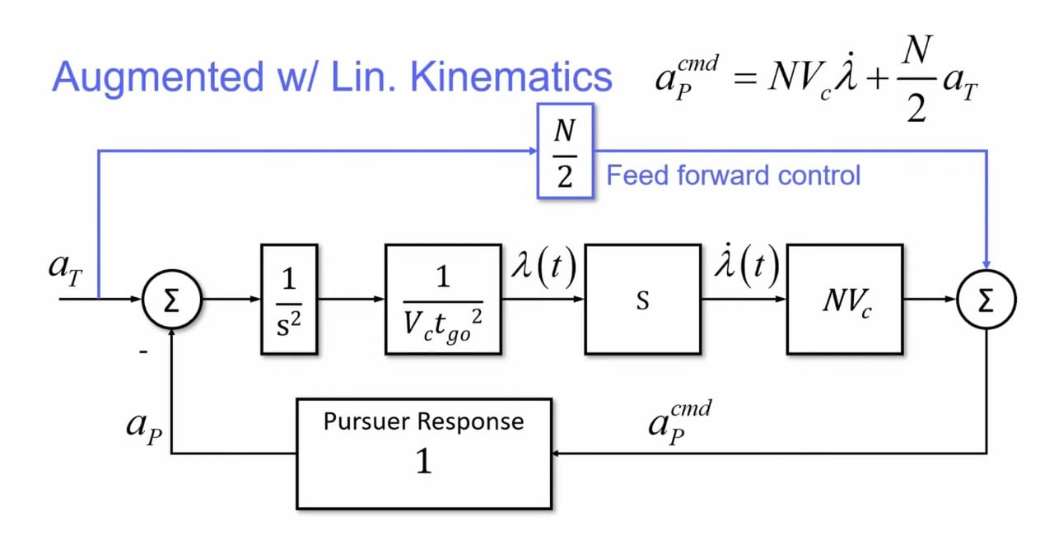
Continued…
Optimal Input becomes

Slide 27
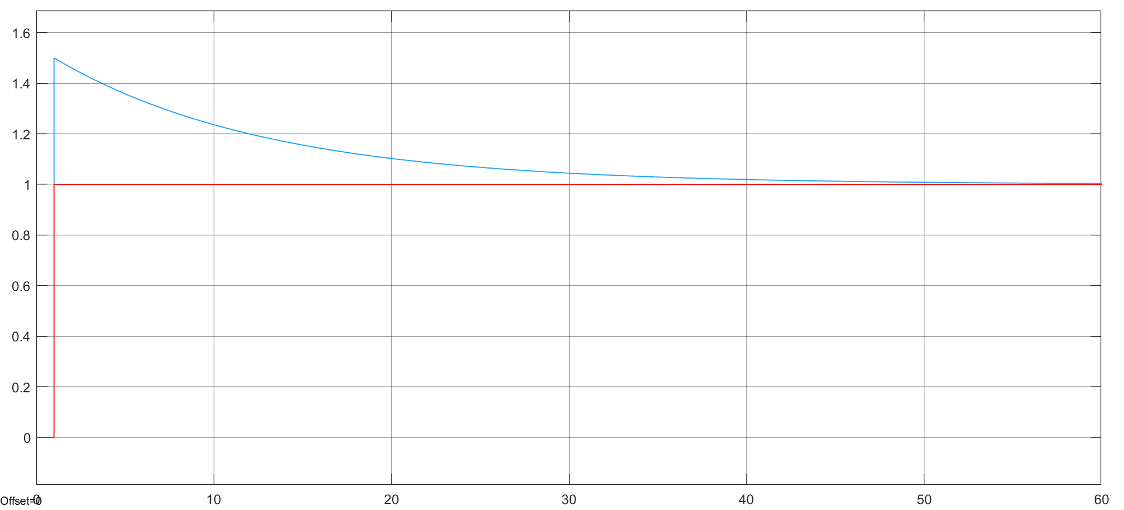
Simulation Result
Step Response of acceleration
Mag.
Time

Slide 28
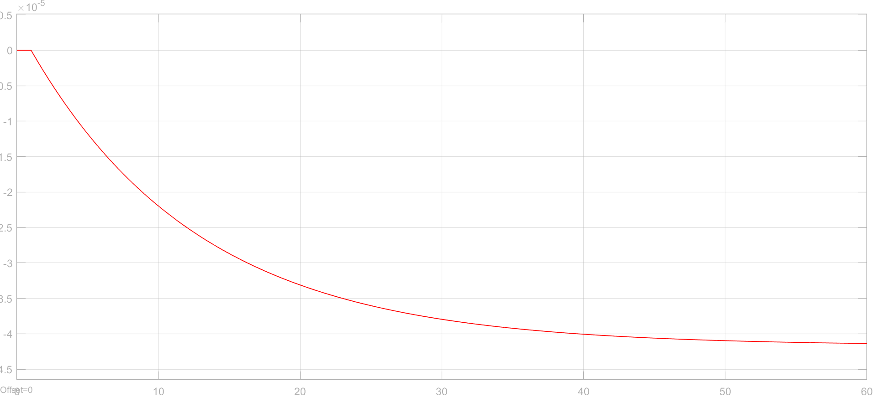
Simulation Result
Response of LOS Rate
Mag.
Time

Slide 29
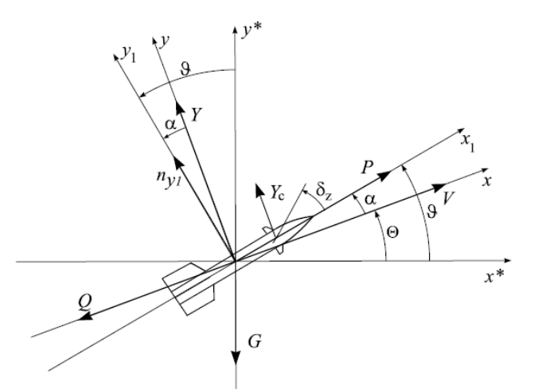
Missile Control
Pitch Plane force fig.

Slide 30
Missile Control System
Translational
Rotation
Leaving the atmposphere the aerodynamics forces and moments become negligible thus gravity remains the only force influencing the flight path of the missile

Slide 31
Continued…
Linearization of eqn
Nominal state space system model

Slide 32
State Space Model
A,B,C,D is given by-
For the Matrix A, the Eigen values -
Corresponding to stable mode are 2+j34.87, 2-j34.87
Corresponding to unstable mode are -106+j106.13,
-106-j106.13
System is Fully controllable and Fully observable

Slide 33
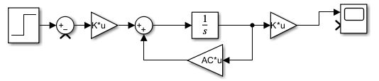
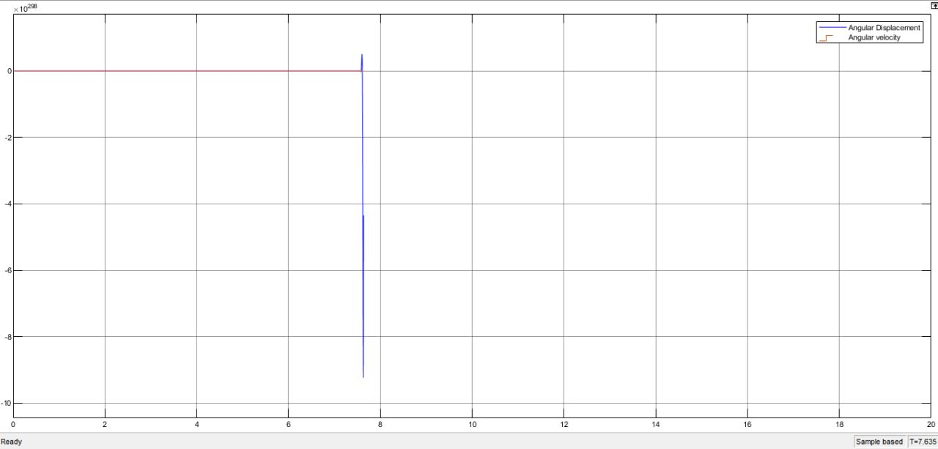
Open Loop Simulation
Mag.
Time

Slide 34
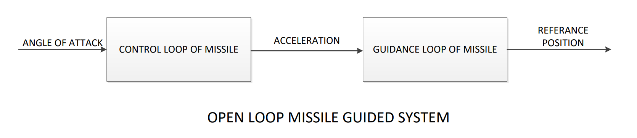
State Space Model for Guidance
State space-

Slide 35
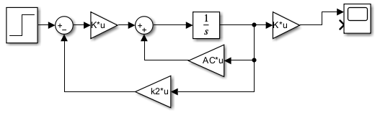
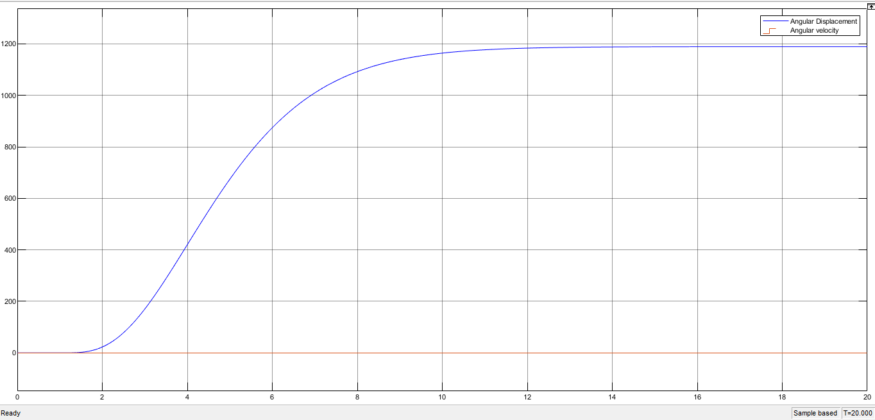
Control with Pole placement
Mag.
Time

Slide 36
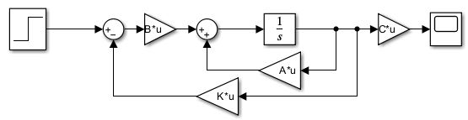
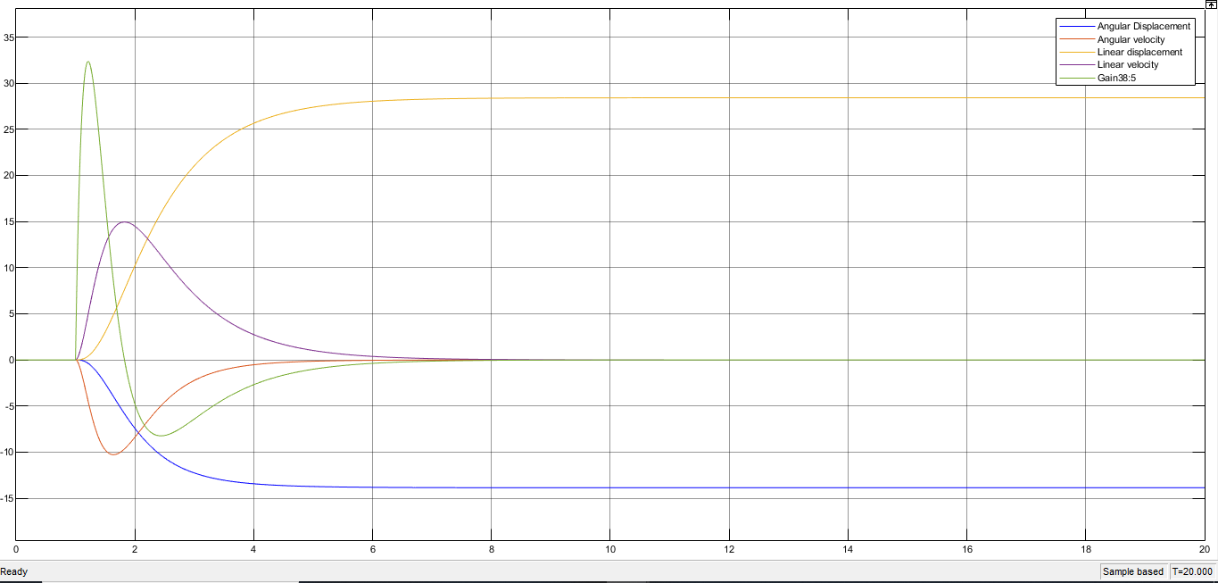
Guidance with Pole Placement
Mag.
Time

Slide 37
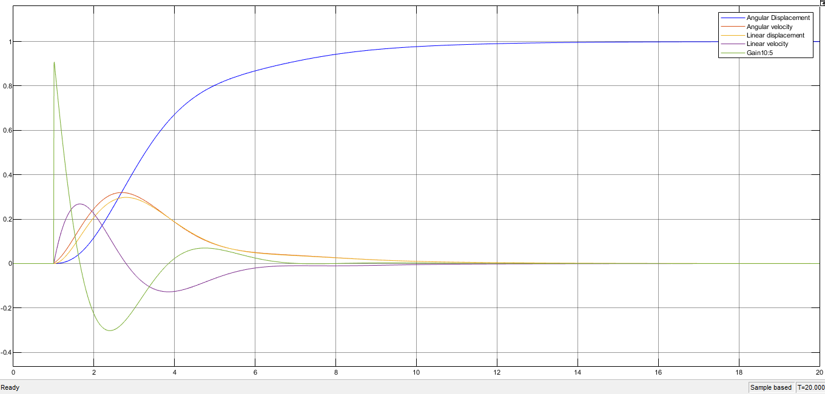
Guidance with LQR
Mag.
Time

Slide 38
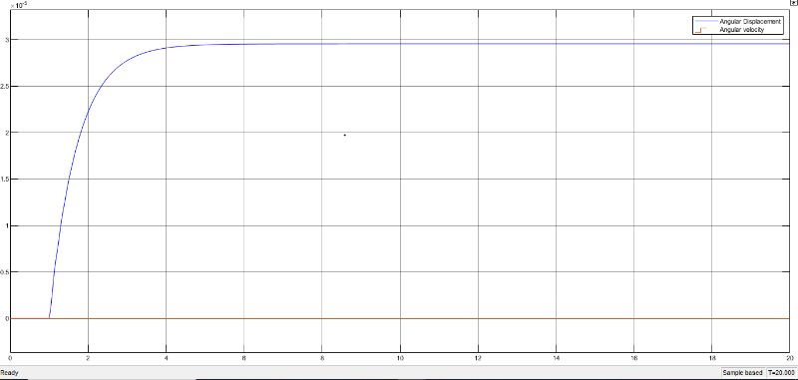
Control with LQR
Mag.
Time

Slide 39
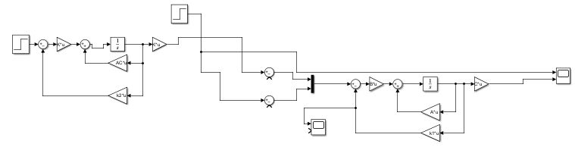
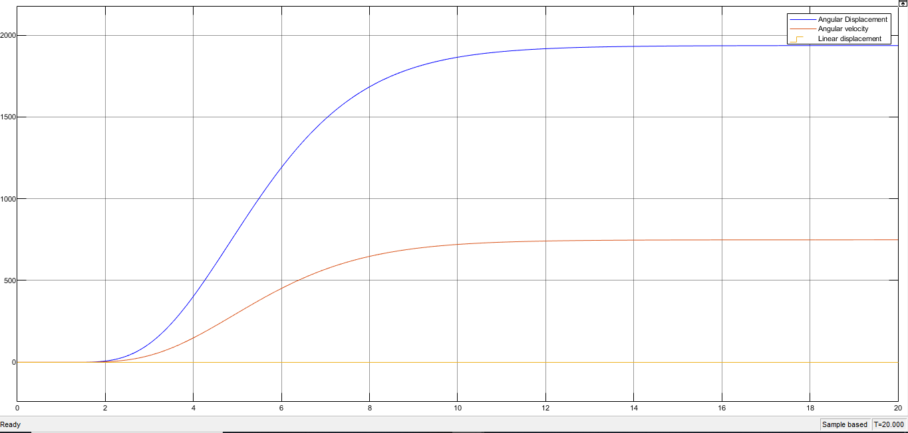

Open loop missile (Control and Guidance)
Mag.
Time
Time

Slide 40
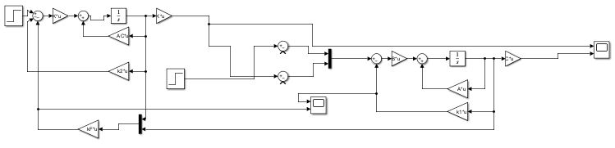
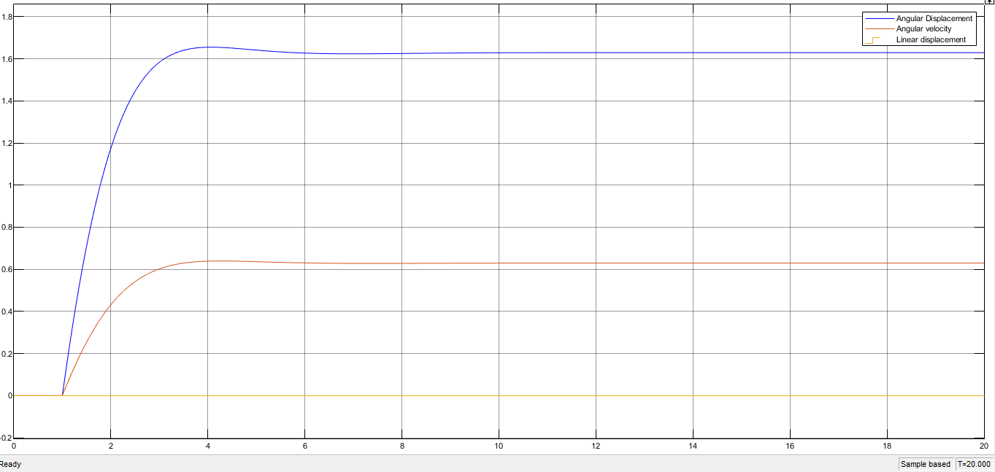
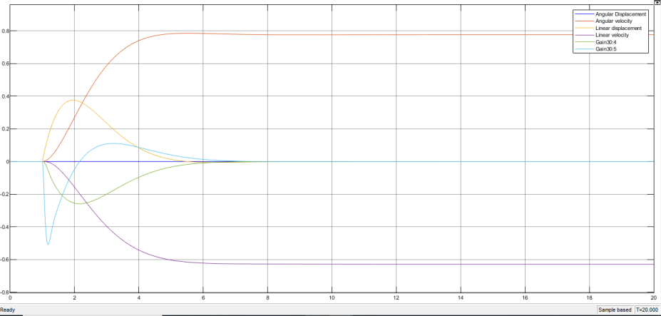
LQR Control of Missile
Mag.
Time
Time

Slide 41
Conclusion
Optimal control for missile guidance step response enables accurate and efficient trajectory tracking,
LQR Controller Improving stability and response time, thereby enhancing missile guidance performance
LQR controller reduce the settling time , error and miss distance of our system with low effort and closing velocity of system is also lower than open loop missile simulation.

Slide 42
References
Paul Zarchan. , Tactical-and-Strategic-missile-guidance sixth edition
Palumbo N.F. , Blauwkamp R.A. , Lloyd J.M. , Modern Homing Missile Guidance Theory and Techniques, John Hopkins APL Technical Digest, v29, n1,2010
Modelling of missile systems with respect to simulation and guidance and control issues-Schloffel G., Theodoulis S., Gnemmi P.
Uwe Mackenroth-Robust Control Systems theory and case studies.
Kanade, Swapnil Pramod, and Abraham T. Mathew. "2 DOF H-infinity loop shaping robust control for rocket attitude stabilization." International Journal of Aerospace Sciences 2, no. 3 (2013): 71-91.

Slide 43
THANK YOU

